Slide 1
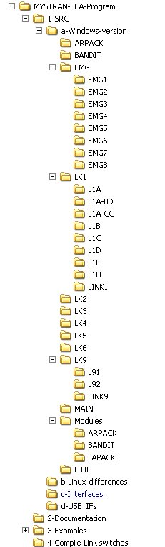

Figure 1: MYSTRAN FEA program file structure
Fig 1-a: Overall
Fig 1-b: SRC subfolder expanded

